Slide 1

6th Grade Math
Unit 8, Lesson 3 Decomposing Quadrilaterals to Find Area Volume 2, pg. 86

Slide 2


Benchmark
MA.6.GR.2.2
Solve mathematical and real-world problems involving the area of quadrilaterals and composite figures by decomposing them into triangles or rectangles.
volume 2, pg. 86

Slide 3
Integrated Mathematical Thinking and Reasoning Standards
MA.K12.MTR.1.1 Actively participate in effortful learning both individually and collectively.
MA.K12.MTR.2.1 Demonstrate understanding by representing problems in multiple ways.
MA.K12.MTR.4.1 Engage in discussions that reflect on the mathematical thinking of self and others.
MA.K12.MTR.5.1 Use patterns and structure to help understand and connect mathematical concepts.
volume 2, pg. 86

Slide 4

Learning Target
I can find the area of quadrilaterals by decomposing them into triangles and rectangles.
volume 2, pg. 86

Slide 5

Warm-Up
volume 2, pg. 86

Slide 6
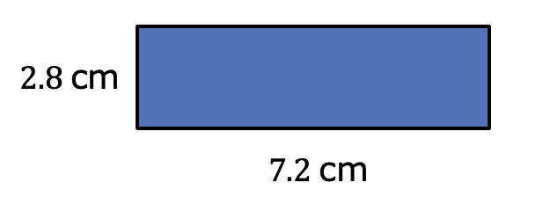
8.3.1 Warm-Up: Perimeter and Area of a Rectangle
A rectangle is shown with side lengths given in centimeters (cm).
Find the perimeter of the rectangle. Include units.
Perimeter = _________
volume 2, pg. 86

Slide 7
Find the area of the rectangle. Include units.
Area = __________
volume 2, pg. 86

Slide 8

Collaboration
volume 2, pg. 87

Slide 9

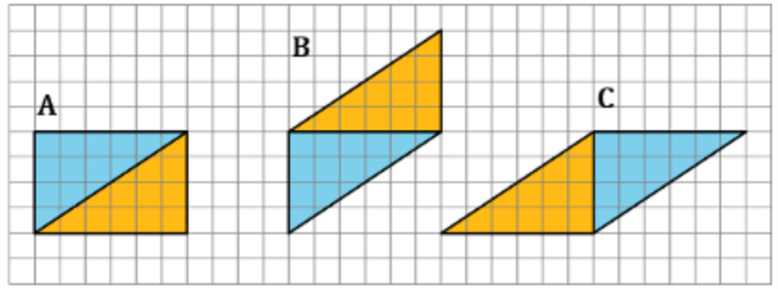
8.3.2 Collaboration: Decomposing Parallelograms
Three parallelograms are shown on the grid. Each square is 1 centimeter (cm) by 1 cm.
volume 2, pg. 87

Slide 10
Work with your partner to complete the table using the figures shown in the grid. Include units.
Parallelogram | Area of Blue Triangle | Area of Gold Triangle | Sum of the Two Triangles
A
B
C
volume 2, pg. 87

Slide 11
Discuss with your partner how the areas of the triangles are related to the area of the parallelogram they form. Write a brief summary of your discussion.
volume 2, pg. 87

Slide 12

Exploration
volume 2, pg. 87

Slide 13

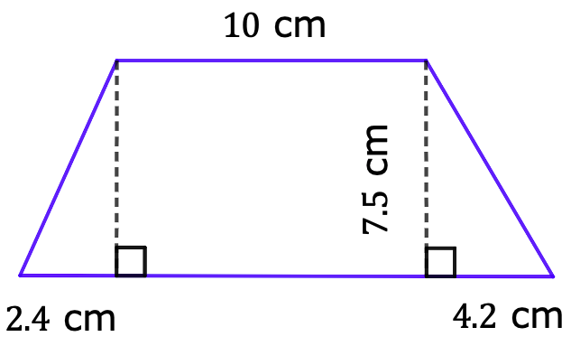
8.3.3 Exploration: Finding Area by Decomposing
A quadrilateral with measurements in centimeters (cm) is shown.
Copy the image on a piece of paper.
Image not drawn to scale
volume 2, pg. 87

Slide 14
Decompose the quadrilateral into two triangles and a rectangle by cutting along the dotted lines. Glue or tape the three figures here.
volume 2, pg. 87

Slide 15
Using the measurements given in the original image, label the base and height of each figure.
What is the area of each figure? Include units.
Find the area of the original quadrilateral by finding the sum of the three figures. Include units.
volume 2, pg. 88

Slide 16
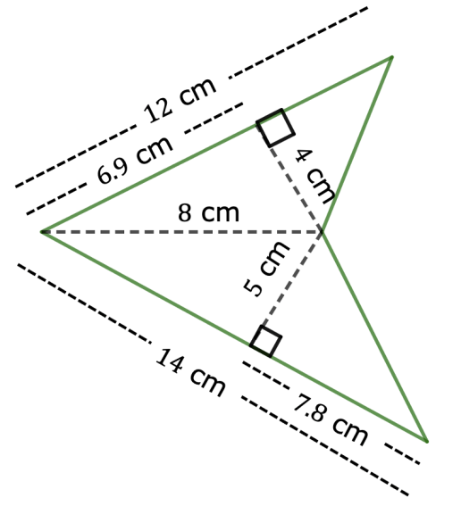
Another quadrilateral is shown.
Decompose the quadrilateral into triangles. Sketch the decomposed triangles here.
Image not drawn to scale
volume 2, pg. 88

Slide 17
Using the measurements given in the original image, label the base and height of each triangle.
volume 2, pg. 88

Slide 18
Find the area of the original quadrilateral by finding the sum of the areas of the decomposed triangles. Include units.
Sketch any other ways you could have decomposed the original figure.
volume 2, pg. 89

Slide 19
Explain if decomposing the figure changes the area of the original figure.
volume 2, pg. 89

Slide 20

Guided Practice
volume 2, pg. 89

Slide 21

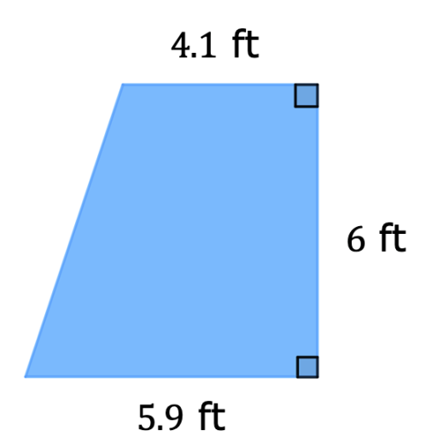
8.3.4 Guided Practice: Finding Area by Decomposing
Decompose the quadrilateral to find the area. Lengths are shown in feet (ft). Include units.
Area = _______________
Image not drawn to scale
volume 2, pg. 89

Slide 22
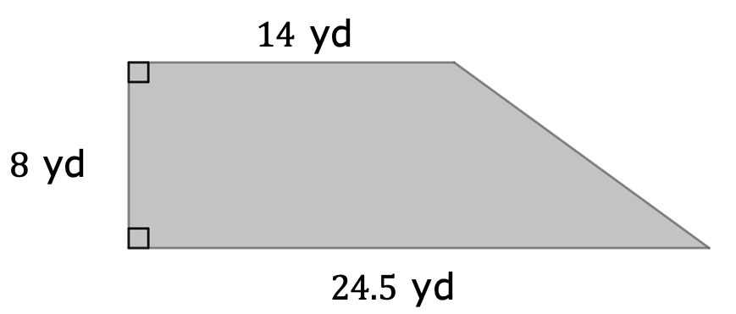

The floor plan of a store is shown with measurements in yards (yd).
The store found $160$ square yards (yd²) of tile on sale. Based on the floor plan drawn, will the store have enough tiles to redo the flooring if they buy what is on sale?
volume 2, pg. 90

Slide 23
Determine the amount of tile, in yd², the store is short or has left over.
volume 2, pg. 90

Slide 24

Your Turn
volume 2, pg. 90

Slide 25
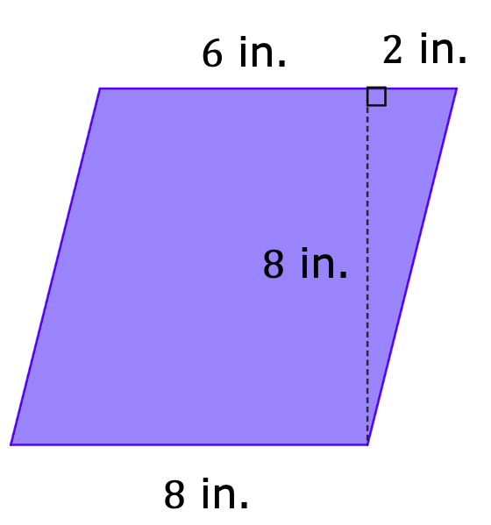
8.3.5 Your Turn!
Find the area of each quadrilateral by decomposing. Lengths are shown in inches (in.). Include units.
Area = _____________
volume 2, pg. 90

Slide 26
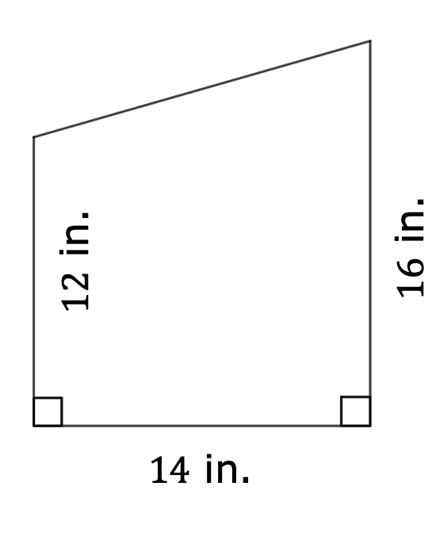
Area = _____________
volume 2, pg. 91

Slide 27
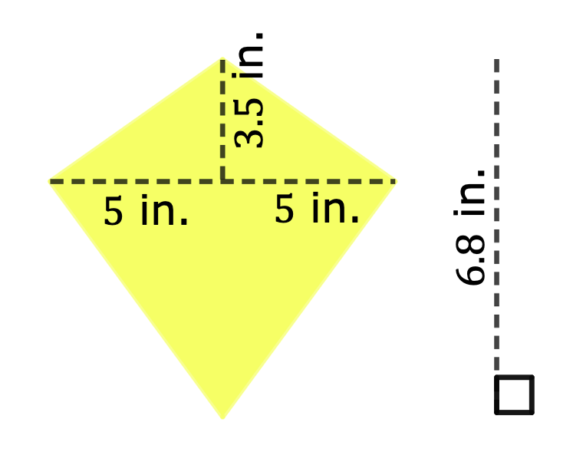
Area = _____________
Image not drawn to scale
volume 2, pg. 91

Slide 28

Wrap-Up
volume 2, pg. 92

Slide 29
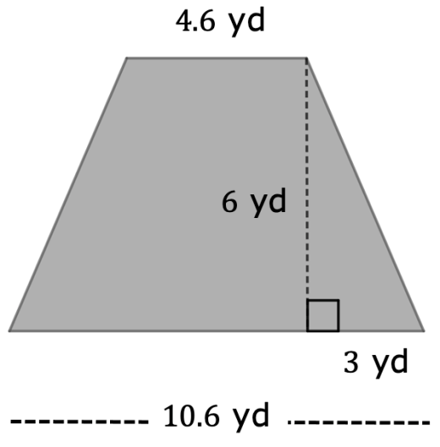
8.3.6 Wrap-Up: Ticket Out the Door
Find the area of each quadrilateral by decomposing. Lengths are given in yards (yd). Include units.
Area = _____________
volume 2, pg. 92

